Slide 1


Smart India Hackathon 2020
Ministry/Organisation name : Govt. of Bihar (DOA)
Team Name : AnnAztecs
College Code : 1-3516007856

Slide 2
Problem Description
Develop a portal for farmer registration along with farm plan.
This plan should help government agencies to monitor the life cycle crop across life cycle.
In case the production fails then provide facility to report that too.
Due to information asymmetry across producers and buyers there emerges a situation of distress sales, this solution may be a step to address this arbitrage situation.
Additionally provide them with advisory of different activities during the farm schedule.
This kind of plan helps government to plan the production and procurement plan, thereby increasing income of farmers.
If there are too many farmers producing same crop they can be recommended/incentivised to produce some other crop.

Slide 3
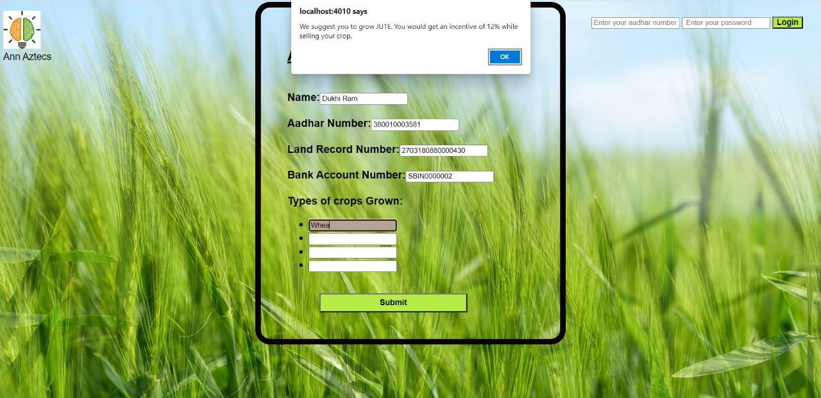
Develop a portal for farmer registration along with farm plan.
Portal created with farmer registration facility.
Farmer would enter his choice of crops.
Alternative crop suggestions would be given dynamically.
Incentives on selling the suggested alternative crop would be given.

Slide 4
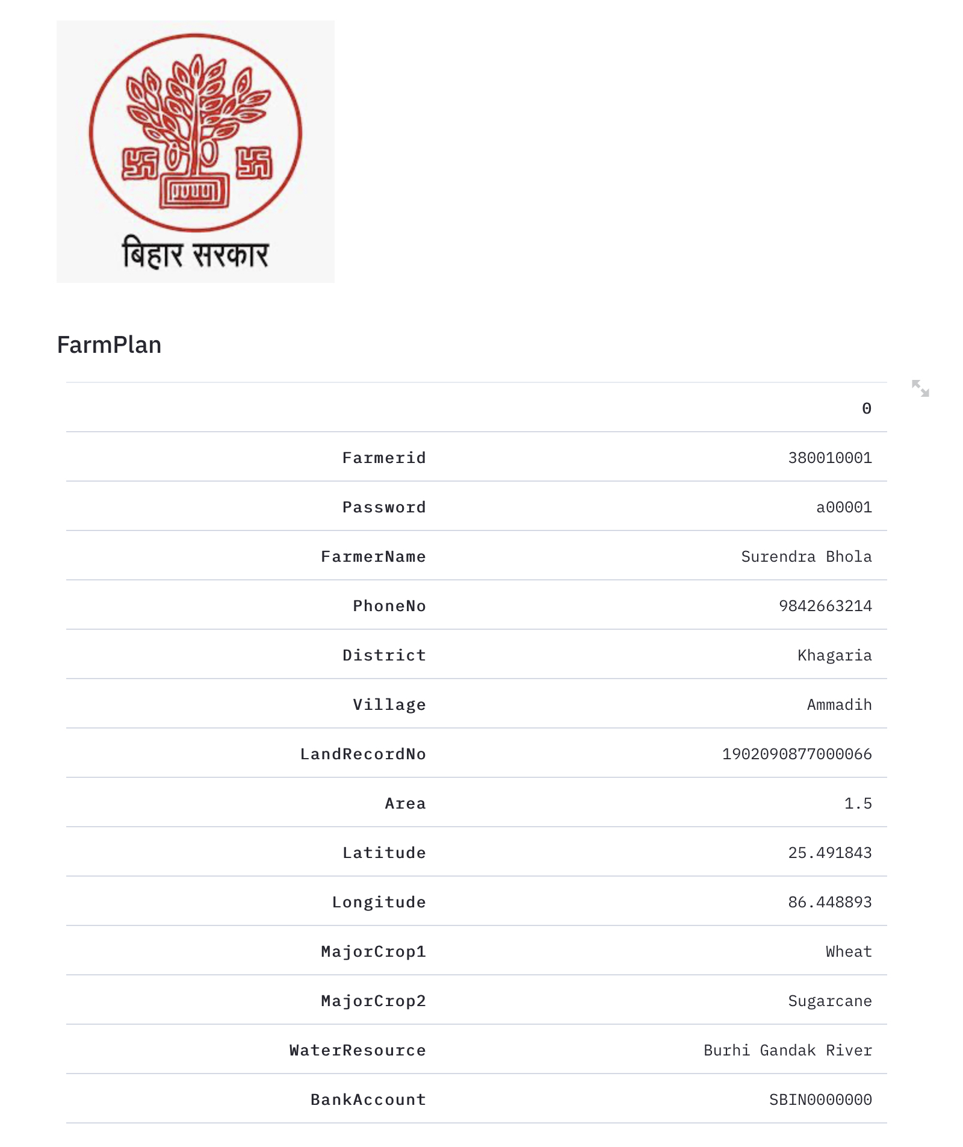
Farm Plan

Slide 5
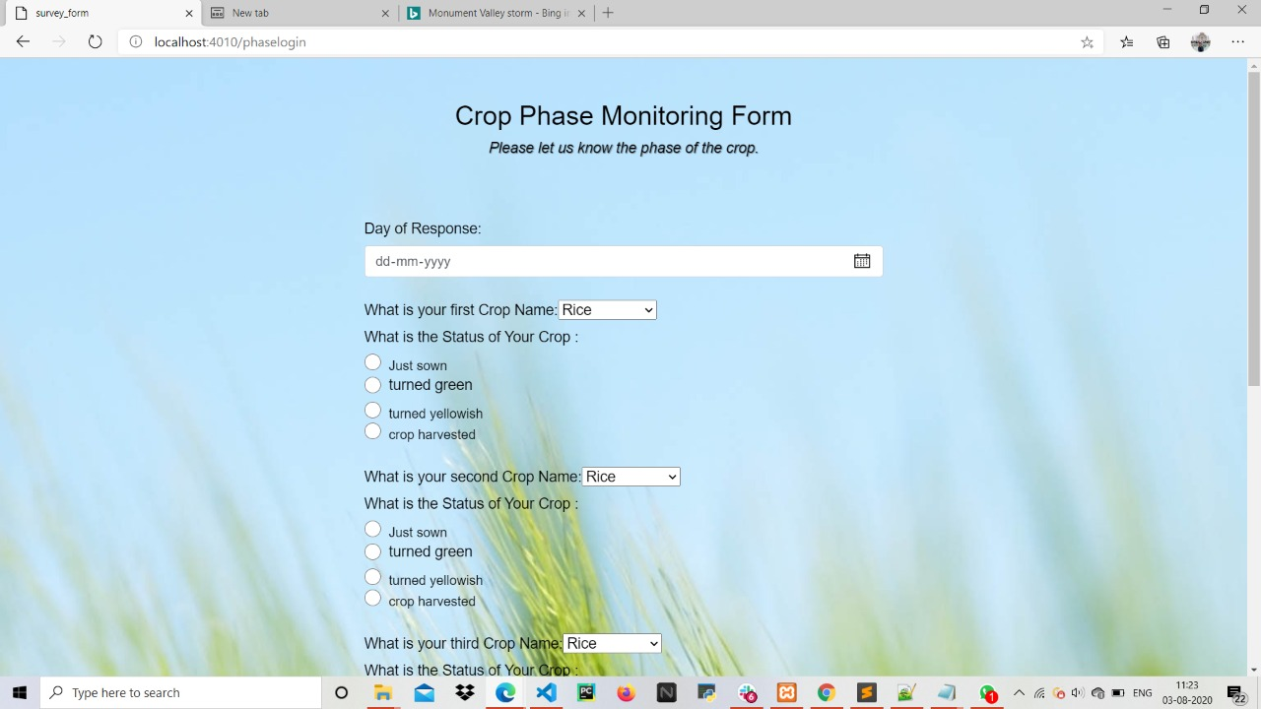
2. This plan should help government agencies to monitor the life cycle crop across life cycle.
A dedicated page on the portal for registering monumental phase change during crop growth.
A farmer can register the phase changes for more than one crops too.
Machine Learning model to cross detect the crops actually grown on farm.

Slide 6
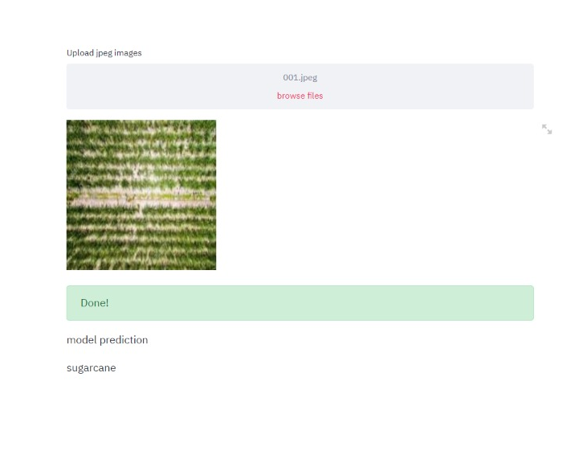
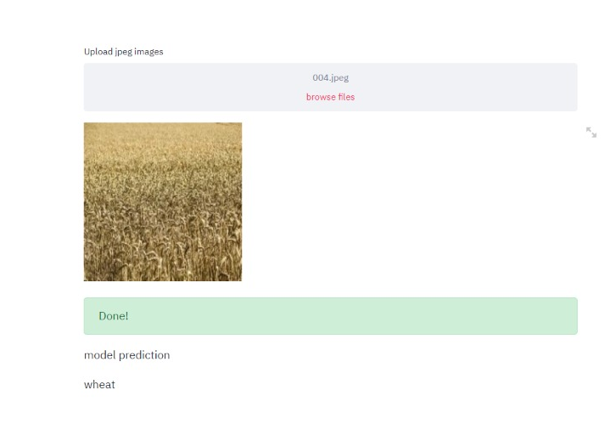
Crop Prediction

Slide 7
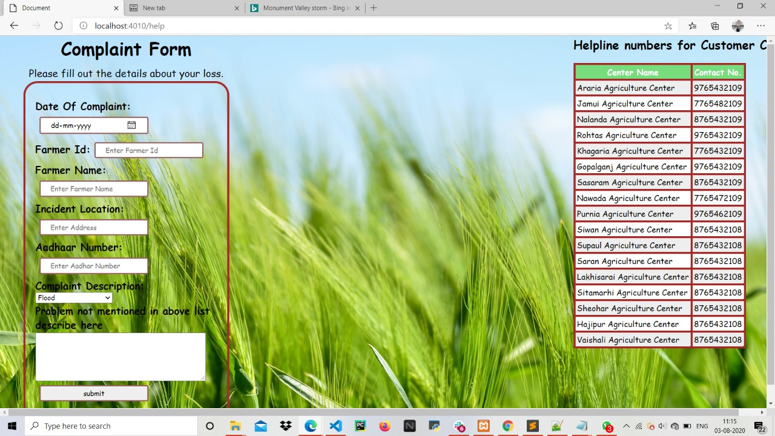
3. In case the production fails then provide facility to report that too.
A page on the portal to report the damage (if any) done to the crop(s).
Beside reporting it on portal, a farmer can seek help on the numbers of local authorities provided at the page itself.
The report of the farmer could also be sent as an e-mail to the local authorities.
Verification of the damage through Machine Learning.
Prediction of the magnitude of loss.

Slide 8
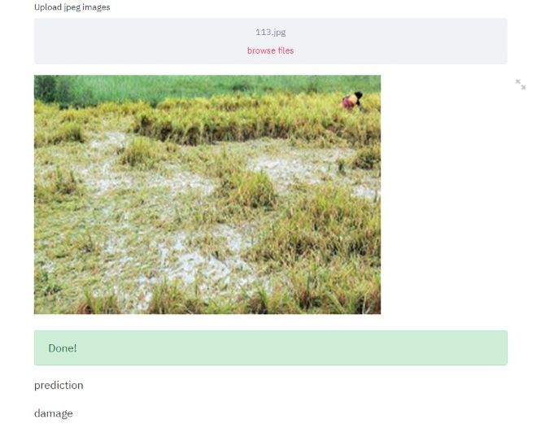

Damage Verification

Slide 9
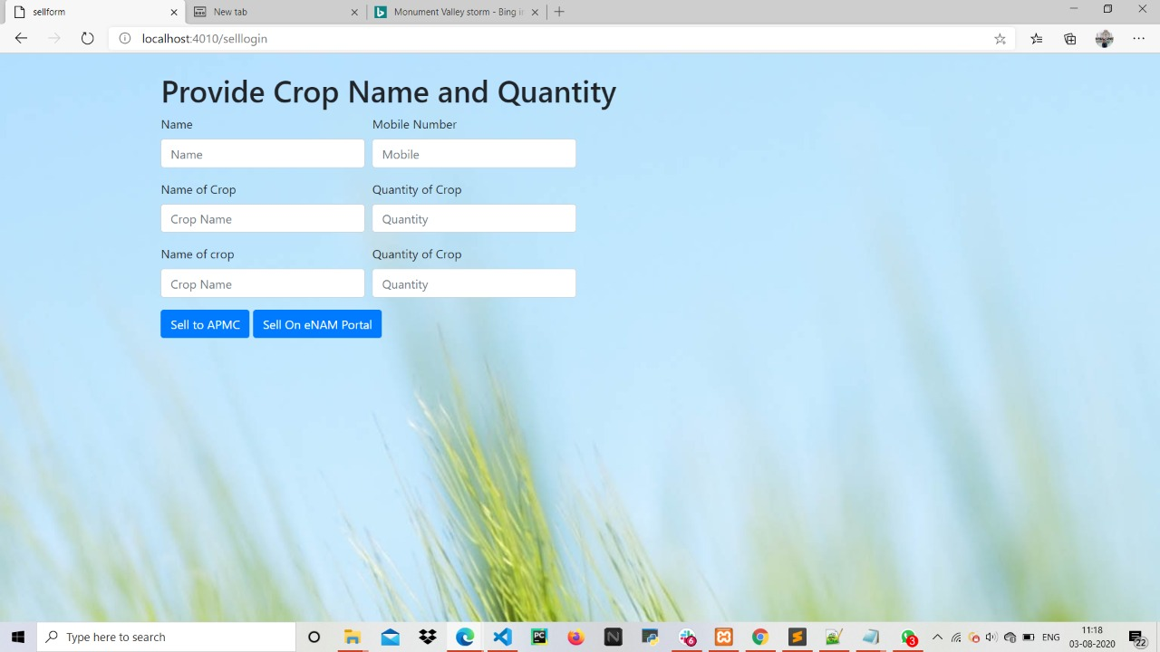
4. Due to information asymmetry across producers and buyers there emerges a situation of distress sales, this solution may be a step to address this arbitrage situation.
6. This kind of plan helps government to plan the production and procurement plan, thereby increasing income of farmers.
7. there are too many farmers producing same crop they can be recommended/incentivised to produce some other crop.
A separate page on the portal where farmers can get an appointment in the local markets to sell their crop(s).
A system of slot booking to avoid long queues.
Accurate yield prediction would be provided to the government, on the basis of which reasonable MSP could be set. This would prevent distress sale.
If a farmer plans to buy seeds, discount would be given if he buys seeds of the previously suggested alternative crop.

Slide 10
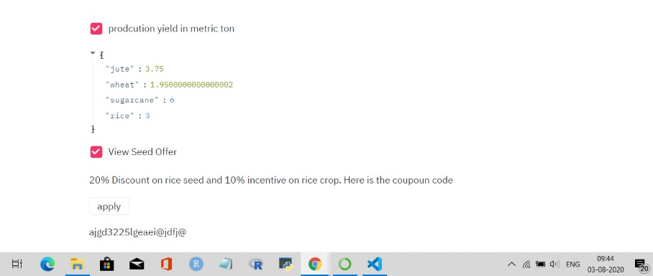
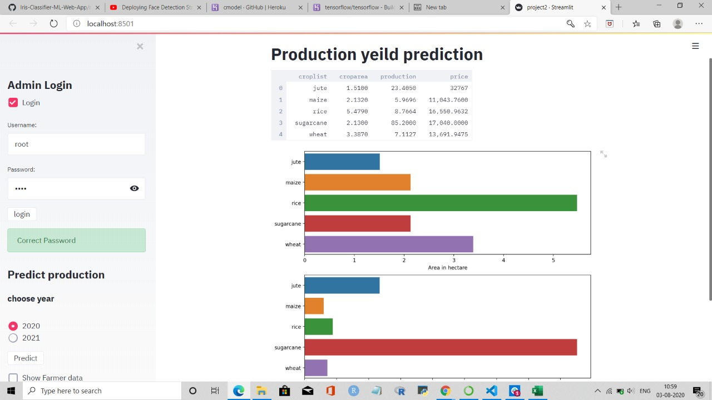
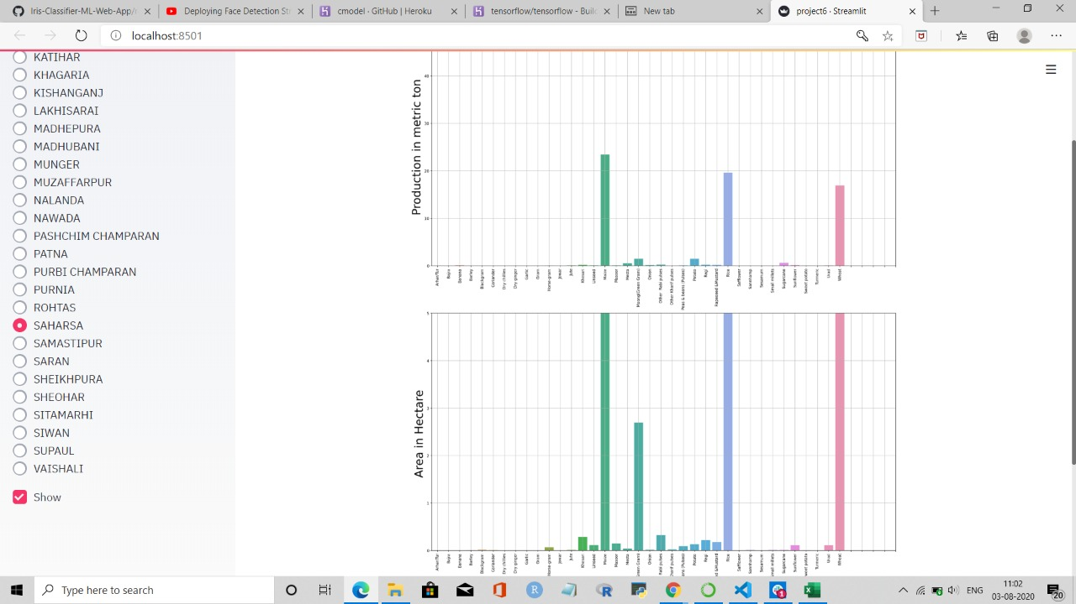
Discount on seeds
Accurate Yield Prediction
District View

Slide 11
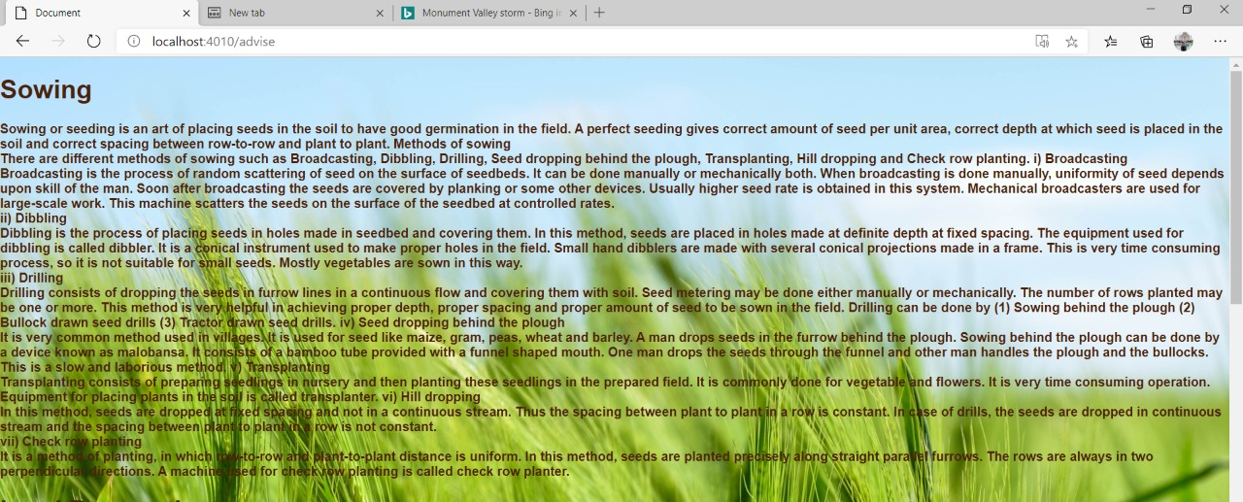
5. Additionally provide them with advisory of different activities during the farm schedule.
Work in progress
Personalised advisory would be given according to the crop phase of the logged farmer.

Slide 12
Notifications of Government’s plans is in progress.
Integration of modules is in progress.
The link of the hosted modules are
-https://farmplan.herokuapp.com
-https://districtview.herokuapp.com

